Slide 1
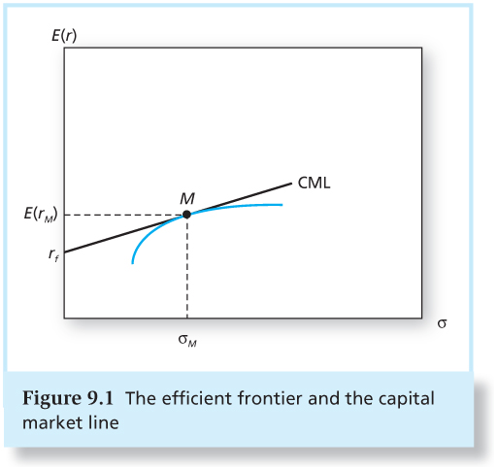
CAPM Review

Slide 2
CAPM Review
Remember, investors can always diversify away all risk except the covariance of an asset with the market portfolio.
Individual security’s risk premium is a function of the individual security’s contribution to the risk of the market portfolio, which is measured by β_{s}
Notes:
Remember the definition of beta, as it is one of the central concepts in finance theory.
what beta measures: the risk added by an investment to a well diversified portfolio. What is β_{M} ?

Slide 3
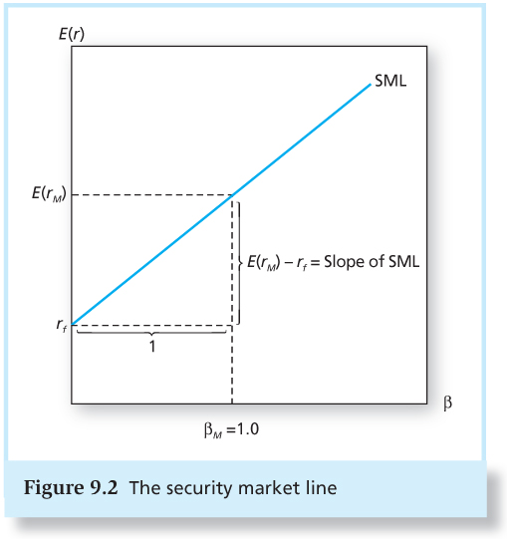
CAPM Review

Slide 4
Arbitrage Pricing Theory and Multifactor Models

Slide 5
Does CAPM Work Historically?
Early academic studies find that CAPM works (in linking historical average stock returns to risk-free rate and betas)
Recent studies find that CAPM does not work well for stocks with certain extreme characteristics. Example:
Small stocks, value stocks, and high-momentum stocks tend to earn higher returns than predicted by CAPM
Large stocks, growth stocks, low-momentum stocks tend to earn lower returns than predicted by CAPM
Some researchers suggest that we need multi-factor models to explain these “anomalies”

Slide 6
APT Introduction
The CAPM has some weakness
We had to make several pretty unrealistic assumptions.
It relies on a hypothetical market portfolio.
Today we will study a different approach to asset pricing called the Arbitrage Pricing Theory or APT.
It requires fewer assumptions.
It considers multiple risks.
The APT assumes a “factor model” of asset returns and specifies a pricing relationship with a number of “systematic” factors.
Notes:
A set of common factors - not just a monolithic market – influence returns.

Slide 7
Multiple Factors and the CAPM
Consider two sources of risk, “technology” and “monetary policy”.
Do all stocks respond the same way to technological innovation?
Do all stocks respond the same way to changes in interest rates?
Returns are multi-dimensional
Multiple common factors that simultaneously affect returns.
The presence of multiple factors makes the CAPM a much more restrictive theory, as CAPM says that each stock has the same relative sensitivity to each component of the macro factor.
Notes:
In CAPM, beta is the sole factor.
Different stocks exhibit different sensitivities to the different components of the macro factor

Slide 8

Arbitrage Pricing Theory
Arbitrage Pricing Theory (APT) was developed by Ross (1976).
APT predicts a security market line as CAPM and shows a linear relation with expected return and risk.

Slide 9
Arbitrage Pricing Theory
Unlike the CAPM, we need very few assumptions to get the APT.
The APT is a multi-factor model of asset pricing.
It is an approach to determine asset values based on no arbitrage and law of one price.
It is derived from a statistical model whereas the CAPM is an equilibrium asset pricing model.
To get the APT, we don’t have to assume that everyone is optimizing.
Recall that we did need this assumption to get the CAPM.
This makes the APT a much more “reasonable” theory.

Slide 10
APT Assumptions
Security returns can be described by a linear (multi-) factor model. There are a few macroeconomic factors influencing returns.
There are sufficient securities so that firm specific (idiosyncratic) risk can be diversified away.
Well-functioning security markets do not allow for persistent arbitrage opportunities.
Notes:
The central idea behind the APT will be that we can price some assets relative to other assets.
a) We will derive restrictions on the price of assets based on no-arbitrage.
b) We will be able to say something stronger if we exclude “near-arbitrage” or extremely good deals.

Slide 11
No Arbitrage
Pricing restriction in the APT comes from the Absence of Arbitrage.
Arbitrage = risk-free profits made by investors by exploiting security mispricing, without a net investment
For example, IBM sold for $170 per share on the NYSE and $165 on the NASDAQ
If security prices allow for arbitrage opportunities, investors will engage in arbitrage activity – buy the cheap one and sell the expensive one.
There will be pressures on prices to adjust and eliminate these risk-free profits.
Notes:
Arbitrage occurs if there is a zero investment portfolio with a sure profit. Since no investment is required, investors can create large positions to obtain large profits.
Regardless of wealth or risk aversion, investors will want an infinite position in the risk-free arbitrage portfolio. In efficient markets, profitable arbitrage opportunities will quickly disappear.
Proceeds from short sales (or borrowing) are used to purchase (take long positions in) other assets
If this zero-net-investment portfolio can sometimes produce a positive return, but can never produce a negative return, then it represents an arbitrage: starting from zero wealth, a profit can sometimes be made but a loss can never occur.
AH share price disparity
•Otherwise there is a chance for arbitrage activity-simultaneously buying the asset where it is cheap and selling where it is expensive.
•During the arbitrage activity, investors will bid up the price where it is low and force it down where it is expensive. As a result they eliminate the arbitrage opportunities.
•Security prices should satisfy a “no-arbitrage condition”.

Slide 12
No Arbitrage
Absence of Arbitrage implies Law of One Price:
Assets that always have the same payoff must have the same price.
No security exists which has a zero price and a strictly positive payoff.
In an efficiently functioning financial market, arbitrage opportunities should not exist (for very long).
Our goal is to come up with a model of security prices where:
If prices/returns obey this model, there is no arbitrage.
If prices/returns fail to obey this model, there is arbitrage.
Notes:
equivalent in all economically relevant aspects
If arbitrage rules are violated, then unlimited risk-free profits are possible.

Slide 13


Slide 14
Factor Model – start with one factor
Single-factor model:
r_{i} = Return on security
β_{i}= Factor sensitivity
Factor = Macro-economic factor, such as business cycles, technology, inflation, interest rate, etc.
F = Surprise in macro-economic factor. F could be positive or negative but has zero mean.
e_{i} = Firm specific surprises (zero mean)
RP = Risk Premium

Slide 15
Well–Diversified Portfolio vs. Security Returns
We already know: A well-diversified portfolio’s return is determined completely by the systematic factor, but the undiversified stock is also subject to nonsystematic risk.
Consider a well-diversified portfolio A
r_{A} = E(r_{A}) + β_{A} F + e_{A}
A: a portfolio such that the firm-specific component of risk is negligible
e_{A} approaches zero as the number of securities in the portfolio increases
Notes:
In a well-diversified portfolio, nonsystematic risk across firms cancels out. Thus only factor risk (systematic risk of the portfolio) affects the risk premium on the security in market equilibrium.

Slide 16
Well–Diversified Portfolio vs. Security Returns
Assume the well-diversified portfolio A:
β_{A} = 1
E(r_{A}) =10%
Assume another well-diversified portfolio B:
β_{B} = 1
E(r_{B}) =8%

Slide 17
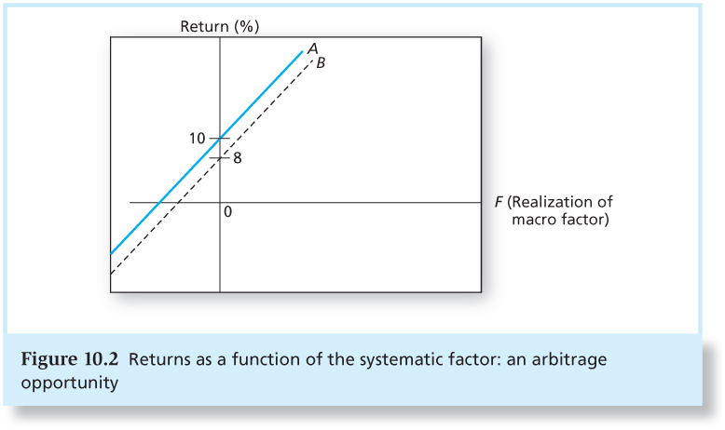
An Arbitrage Opportunity

Slide 18
An Arbitrage Opportunity
No matter what the systematic factor F turns out to be, portfolio A always outperforms B, leading to an arbitrage opportunity.
How?
Long A and short B to make positive profits. Such profit is risk-free because the factor risk cancels out across the positions.
For example, sell short $1 million of B and buy $1 million of A, you would have a riskless payoff of $20,000, with zero net investment.

Slide 19
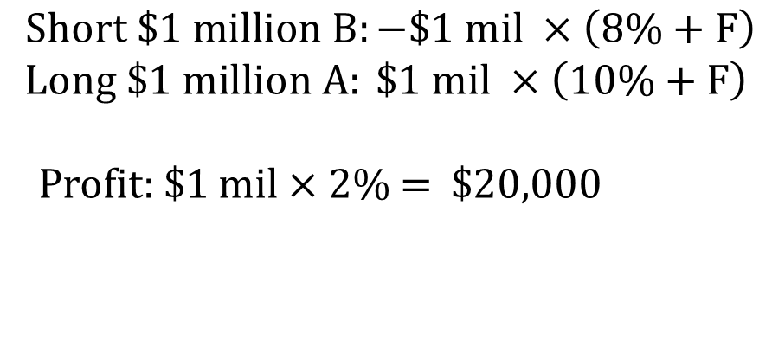
$$Short \$1 million B:−\$1 mil ×\left(8\%+F\right)$$
$$Long \$1 million A: \$1 mil ×\left(10\%+F\right)$$
Profit: $1 mil × 2% = $20,000

Slide 20
An Arbitrage Opportunity
Implication: Well-diversified portfolios with equal betas must have equal expected returns, or arbitrage opportunities exist.
What about portfolios with different betas?

Slide 21
An Arbitrage Opportunity
Given another well-diversified portfolio C
β_{C} = 0.5, E(r_{C}) =6%
Assume portfolio D is composed of half A and half risk-free asset, with r_{f} = 4%
D has an equal beta but a greater expected return than C
β_{D} =
0.5 ×1 + 0.5 × 0 = 0.5
E(r_{D}) =
0.5 ×10% + 0.5 × 4% = 7%
Arbitrage opportunity?
Notes:
Compare A and C

Slide 22
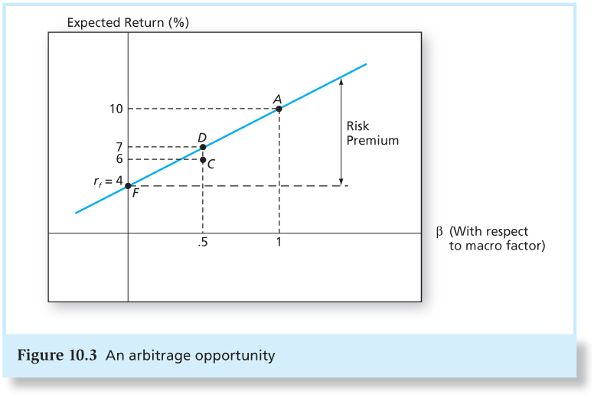
An Arbitrage Opportunity
To preclude arbitrage opportunities, the expected return on all well-diversified portfolio must line on the straight line from the risk-free asset.

Slide 23
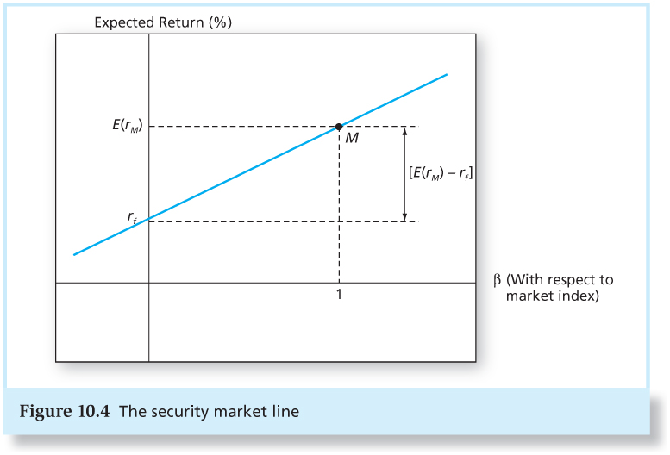
APT – One Factor: Market Index M
Assume the only systematic risk: unexpected return on M
No-arbitrage condition leads to a SML relation equivalent to that of the CAPM.

Slide 24
APT and CAPM
One of the important differences between CAPM and arbitrage arguments (APT).
Under the CAPM, when a security is mispriced, almost all investors will make limited portfolio changes → restore equilibrium
Under the APT, any investor who identifies an arbitrage opportunity will want an infinite position in the risk-free arbitrage portfolio → restore equilibrium
Notes:
The law of one price states that if two assets are equivalent in all economically relevant respects, then they should have the same market price.
•Otherwise there is a chance for arbitrage activity-simultaneously buying the asset where it is cheap and selling where it is expensive.
•During the arbitrage activity, investors will bid up the price where it is low and force it down where it is expensive. As a result they eliminate the arbitrage opportunities.
•Security prices should satisfy a “no-arbitrage condition”.
If security prices allow for arbitrage opportunities, the market is not in equilibrium. Regardless of wealth or risk aversion, investors will want an infinite position in the risk-free arbitrage portfolio.

Slide 25
APT and CAPM
APT
CAPM
APT equilibrium means no arbitrage opportunities.
APT equilibrium is quickly restored even if only a few investors recognize an arbitrage opportunity.
The expected return–beta relationship can be derived without using the true market portfolio.
Model is based on an inherently unobservable “market” portfolio.
Rests on mean-variance efficiency. The actions of many small investors restore CAPM equilibrium.
CAPM describes equilibrium for all assets.
Notes:
limits to arbitrage

Slide 26
APT Model - More
APT applies to well-diversified portfolios, but not necessarily to individual stocks.
If the no-arbitrage expected return-beta relationship has to hold for infinitely many different, well-diversified portfolios, it must be virtually certain that the relationship holds for all but a small number of individual securities.
With APT it is possible for some individual stocks to be mispriced - not lie on the SML.
APT can be extended to multifactor models.

Slide 27
Exercises
Consider the following data for a one-factor economy. All portfolios are well diversified. Suppose that another portfolio, portfolio E, is well diversified with a beta of 0.6 and expected return of 7%. Would an arbitrage opportunity exist? If so, what would be the arbitrage strategy?
A portfolio composed of half A and half F:
β = 0.5 ×1.2 + 0.5 × 0 = 0.6
E(r) = 0.5 ×12% + 0.5 × 6% = 9% > 7%
Strategy: short portfolio E, and long this new portfolio
Portfolio | Expected Return | Beta
A | 12% | 1.2
F | 6% | 0.0

Slide 28
A Two-Factor Model
The multifactor APT is similar to the one-factor case.

Slide 29
A Two-Factor Model - Example
Suppose we believe the only macroeconomic sources of risk are business cycles (GDP) and interest rates fluctuations (IR)
Rates of return should then respond to unanticipated changes in both factors
r_{i} = Return for security i
β_{GDP} = Factor sensitivity for GDP
β_{IR} = Factor sensitivity for Interest Rate
GDP/IR = Unanticipated changes in macro-factors
e_{i} = Firm specific surprises

Slide 30
Exercises
Suppose that there are two independent economic factors, F₁ and F₂. The risk-free rate is 6%, and all stocks have independent firm-specific components with a standard deviation of 45%. The portfolio A and B are well-diversified portfolios. Please use the following information to find the risk premium of each factor and find the expected return-beta relationship in this economy.
Portfolio |  | Beta on F₁ | Beta on F₂ |  |  | Expected Return
A | 1.5 |  |  | 2.0 | 31%
B | 2.2 |  |  | -0.2 | 27%

Slide 31
Exercises
E(r_{p} ) = r_{f} + β_{P1} RP₁ + β_{P2} RP₂
0.31 = 0.06 + (1.5 × RP₁ ) + (2.0 × RP₂ )
0.27 = 0.06 + (2.2 × RP₁ ) + [(–0.2) × RP₂ ]
RP₁ = 10% and RP₂ = 5%
Thus, the expected return-beta relationship is:
E(r_{P} ) = 6% + (β_{P1} × 10%) + (β_{P2} × 5%)

Slide 32
Multifactor APT
Its ability to price asset will depend on getting the “right” factors.
Unfortunately, the multifactor APT gives no guidance concerning the determination of the relevant risk factors
What factors?
Factors that are important to performance of the general economy
What about firm characteristics, i.e., firm size, book/market?

Slide 33


Fama-French Three-Factor Model

Slide 34
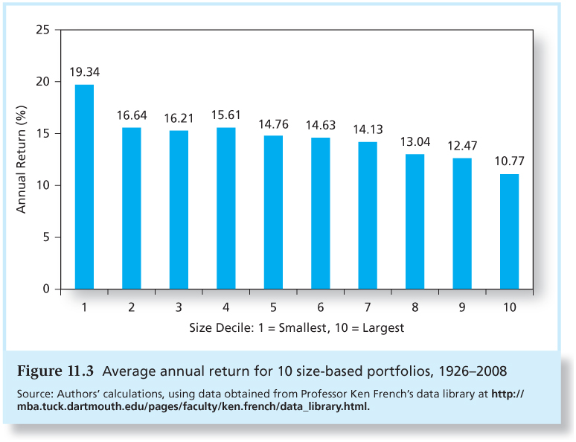
Average Annual Return for Size-based Portfolios
Notes:
Beginning in the early 1980’s a number of studies found that the stocks of small firms typically outperform (on a risk-adjusted basis, CAPM) the stocks of large firms.
This is even true among the large-capitalization stocks within the S&P 500. The smaller (but still large) stocks tend to outperform the really large ones.

Slide 35
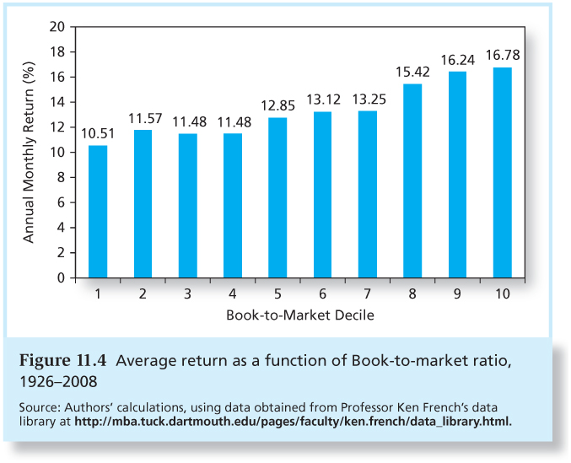
Average Annual Returns for B/M-based Portfolios
Notes:
Higher book to market higher return
High book to market: Value stock
Low book to market: growth stock

Slide 36
Fama-French Three-Factor Model
$${CAPM estimation: r}_{i}−r_{f}=α_{i}+b_{i}(r_{M}−r_{f})+e_{i}$$
SMB = Small Minus Big, i.e., the return of a portfolio of small stocks in excess of the return on a portfolio of large stocks.
HML = High Minus Low, i.e., the return of a portfolio of stocks with a high book-to-market ratio in excess of the return on a portfolio of stocks with a low book-to-market ratio.
Are these firm characteristics correlated with actual (but currently unknown) systematic risk factors?
maybe
$$r_{i}−r_{f}=α_{i}+b_{i}(r_{M}−r_{f})+s_{i}SMB+h_{i}HML+e_{i}$$

Slide 37
Summary
The APT is an alternative model to the CAPM. It makes fewer assumptions, and as a result gets weaker predictions.
The APT does not say what the systematic factors are, whereas the CAPM says that the market portfolio is the only systematic source of risk.
Once the factors are identified, the APT can be used as a performance measurement tool as well.

Slide 38
More Exercises
Your opinion is that Boeing has an expected rate of return of 0.0952. It has a beta of 0.92. The risk-free rate is 0.04 and the market risk premium is 0.06. According to the Capital Asset Pricing Model, is this security fairly priced? Any misevaluation?
Yes, it is fairly priced.
$$E\left(r\right)=0.04+0.92×0.06=0.0952$$
Notes:
E=0.04+0.92*0.06=0.0952

Slide 39
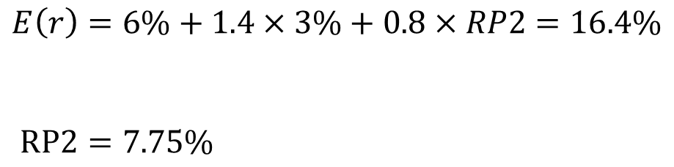
More Exercises
Consider the multifactor APT with two factors. Stock A has an expected return of 16.4%, a beta of 1.4 on factor 1 and a beta of 0.8 on factor 2. The risk premium on the factor 1 portfolio is 3%. The risk-free rate of return is 6%. What is the risk-premium on factor 2 if no arbitrage opportunities exist?
$$E\left(r\right)=6\%+1.4×3\%+0.8×RP2=16.4\%$$
$$RP2=7.75\%$$
Notes:
RP2=7.75

Slide 40
Review
The APT makes fewer assumptions and is a multi-factor model of asset pricing.
The APT does not say what the systematic factors are, whereas the CAPM says that the market portfolio is the only systematic source of risk.
The APT is an approach to determine asset values based on no arbitrage and law of one price.
APT equilibrium is quickly restored even if only a few investors recognize an arbitrage opportunity.
APT applies to well-diversified portfolios but not necessarily to individual stocks.

Slide 41
Review
Assume the only systematic risk: unexpected return on M
No-arbitrage condition leads to a SML relation equivalent to that of the CAPM.

Slide 42
Review
APT
CAPM
APT equilibrium means no arbitrage opportunities.
APT equilibrium is quickly restored even if only a few investors recognize an arbitrage opportunity.
The expected return–beta relationship can be derived without using the true market portfolio.
Model is based on an inherently unobservable “market” portfolio.
Rests on mean-variance efficiency. The actions of many small investors restore CAPM equilibrium.
CAPM describes equilibrium for all assets.
Notes:
limits to arbitrage

